Slide 1

Department of Computer Science and Engineering
Name of Student(With PRN ):-
1. 2267571242501 Shashikant Kailas Shinde
2. 2167571242054 Atharv Shridhar Bakare
3. 2167571242050 Shivkumar Vijaykumar Sapkal
Name of Project Topic:-
E- Vehicle Wireless Charging station Prototype and Small robots Wireless charging station
Name of guide: Prof. Kiran P. Jagtap

Slide 2
Relevance :-
The relevance of the project is in meeting the demand for efficient, secure, and user-friendly EV charging solutions. By offering a wireless, IoT-enabled system, it enhances convenience, enables real-time monitoring, and supports smart city initiatives with data-driven energy management.
Problem identification:-
The Wireless E-Vehicle Charging Station IoT Project tackles key issues in EV charging, including inconvenient physical plug-ins, lack of limited security, inefficient energy management, and minimal IoT integration.
By creating a wireless, IoT-enabled charging solution, the project aims to improve convenience, enhance security, optimize energy usage.

Slide 3
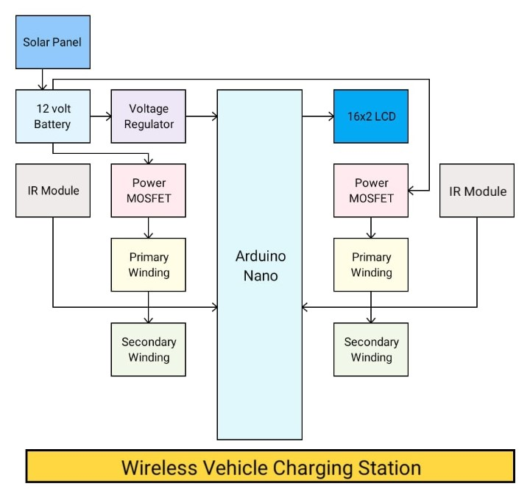
Block Diagram :-

Slide 4
Hardware Development Requirement :-
1)Arduino uno
2) RFID Reader Module
3) IR Sensor
4) Sg90 Servo Motor
5) 1 Channel 5v Relay Module
6) Wireless Charging Module
7) uno Cable
8) 5v Adaptor
9) Sunboard Sheet
10) Black Chart
11) Ribbon Wire
12)Node Mcu 8266
13)Tesla primary and secoundry coil
Software Development Requirement :-
C, C++ , Arduino IDE

Slide 5
Scope of Project :-
The scope of the Wireless E-Vehicle Charging Station IoT Project includes developing a cablefree, IoT-enabled charging solution for electric vehicles. This system provides secure, user-friendly wireless charging.
It addresses the need for efficient EV infrastructure, reduces manual handling, enhances user convenience, and supports smart city energy management by gathering data on charging patterns and energy usage.
Objective:-
Develop a Desktop Software modules
Receipt Generator

Slide 6
Proposed work :-
The Wireless E-Vehicle Charging Station IoT Project aims to develop a wireless EV charging system with IoT integration for secure, efficient charging. Key components include RFID for authentication, IR sensors for vehicle detection, and a relay for power control, all managed via an IoT platform.
Motivation for work:-
The goal of the Wireless E-Vehicle Charging Station IoT Project is to improve the EV charging experience by eliminating the need for physical connections and integrating IoT for enhanced convenience and security. The project aims to provide authenticated access, and optimized energy usage, supporting sustainable development and aligning with the growing demand for smart

Slide 7

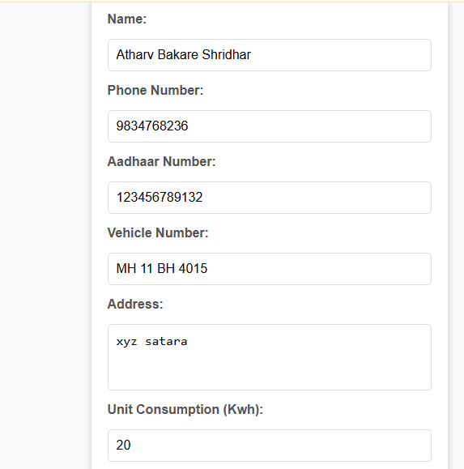
Desktop App Interfase

Slide 8
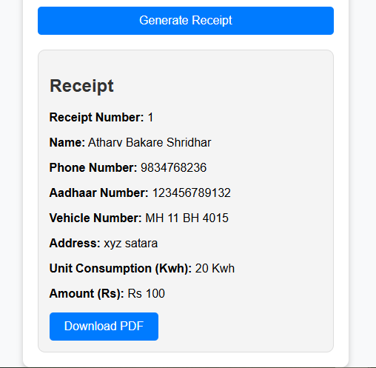

Slide 9
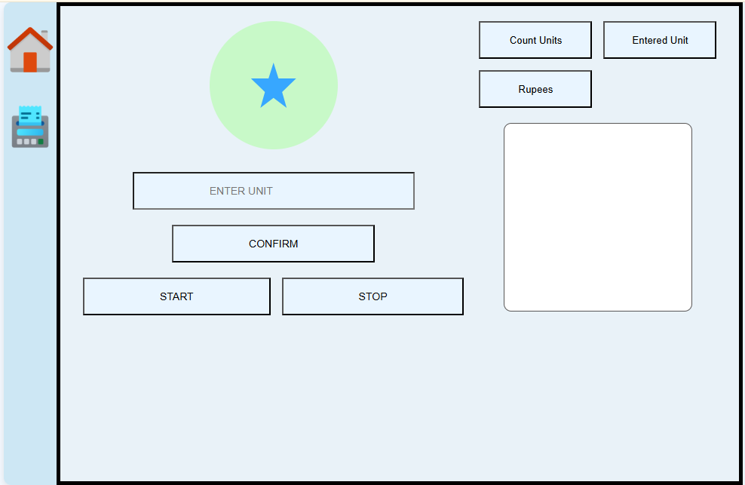

Slide 10


Slide 11
Expected Outcome :-
The expected outcome of the project is a wireless, IoT-enabled EV charging system that offers secure, convenient, and efficient charging. It will include RFID-based authentication, automated charging activation, and data analytics for energy management, supporting smart city infrastructure and sustainable energy use.
Expected Date of Completion: 25/03/2025
Approximate Expenditure: 6000

Slide 12
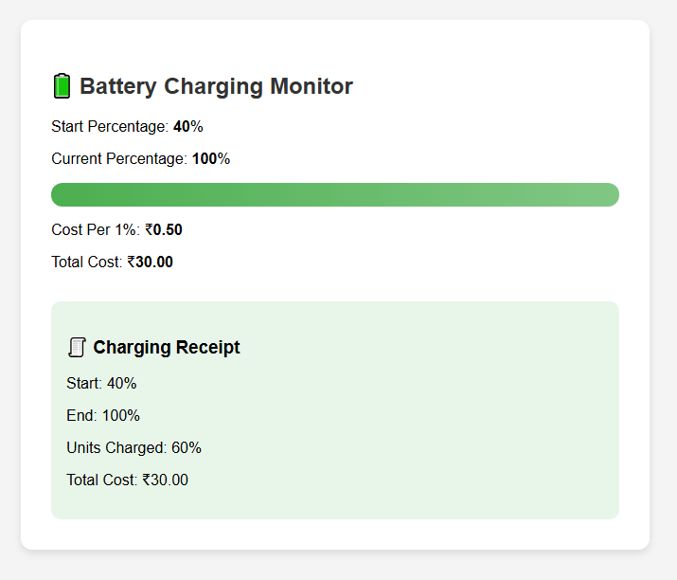
Small robots battery charging invoice

Slide 13
THANK YOU

